Slide 1
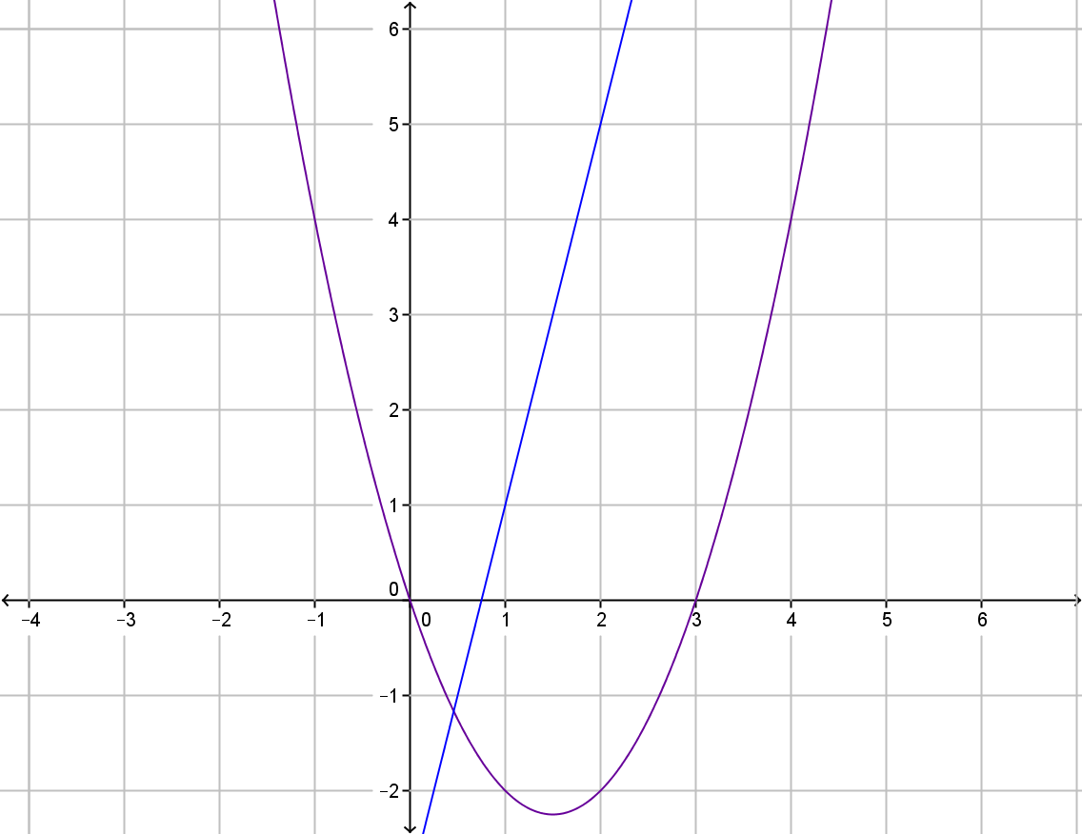
My Non-Linear Relationships Interactive Notebook
Name
Class
Term 4 Semester 2

Slide 2
Contents
Formula Page
Page
Date
Description
2
3

Slide 3
Tasks
24
7
30
Essential Question
Questions
Notes
Summary
8
9

Slide 4
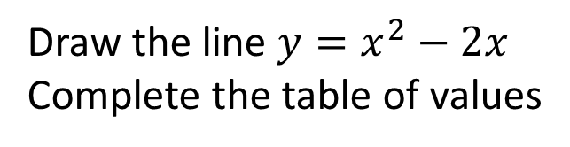
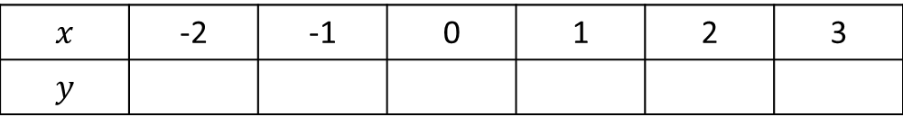
24
7
30
Date
Drawing quadratic graphs
EQ – Describe how to draw a graph in the form $y={ax}^{2}+bx+c$
Draw the line $y=x^{2}−2x$
Complete the table of values
$$x$$ | -2 | -1 | 0 | 1 | 2 | 3
$$y$$
9

Slide 5
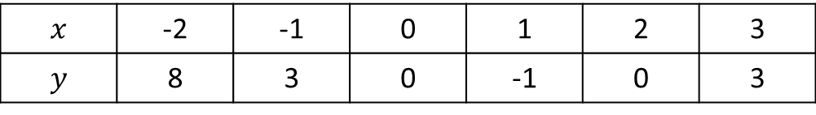
24
7
30
Date
Drawing quadratic graphs
EQ – Describe how to draw a graph in the form $y={ax}^{2}+bx+c$
Draw the line $y=x^{2}−2x$
Complete the table of values
$$x$$ | -2 | -1 | 0 | 1 | 2 | 3
$$y$$ | 8 | 3 | 0 | -1 | 0 | 3
9

Slide 6
24
7
30
Date
Drawing quadratic graphs
EQ – Describe how to draw a graph in the form $y={ax}^{2}+bx+c$
Draw the line $y=x^{2}−2x$
Complete the table of values
$$x$$ | -2 | -1 | 0 | 1 | 2 | 3
$$y$$ | 8 | 3 | 0 | -1 | 0 | 3
Draw a set of axes and draw the graph
9

Slide 7
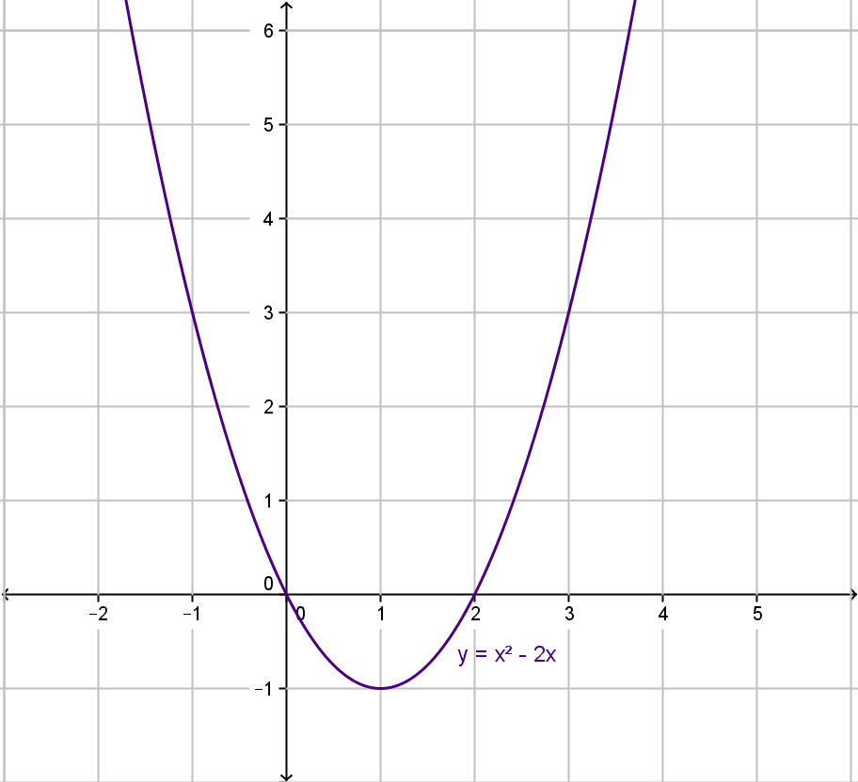

Slide 8
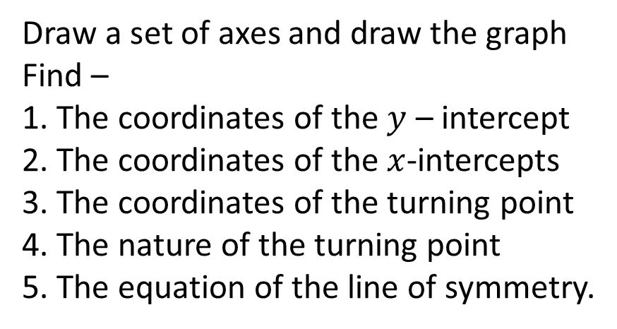
24
7
30
Date
Drawing quadratic graphs
EQ – Describe how to draw a graph in the form $y={ax}^{2}+bx+c$
Draw the line $y=x^{2}−2x$
Complete the table of values
$$x$$ | -2 | -1 | 0 | 1 | 2 | 3
$$y$$ | 8 | 3 | 0 | -1 | 0 | 3
Draw a set of axes and draw the graph
Find –
1. The coordinates of the $y$ – intercept
2. The coordinates of the $x$-intercepts
3. The coordinates of the turning point
4. The nature of the turning point
5. The equation of the line of symmetry.
9

Slide 9
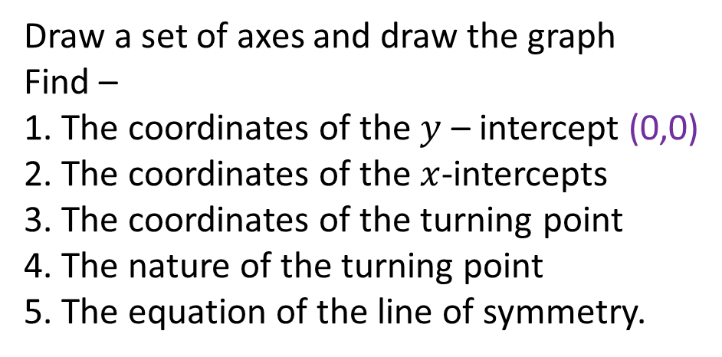
24
7
30
Date
Drawing quadratic graphs
EQ – Describe how to draw a graph in the form $y={ax}^{2}+bx+c$
Draw the line $y=x^{2}−2x$
Complete the table of values
$$x$$ | -2 | -1 | 0 | 1 | 2 | 3
$$y$$ | 8 | 3 | 0 | -1 | 0 | 3
Draw a set of axes and draw the graph
Find –
1. The coordinates of the $y$ – intercept (0,0)
2. The coordinates of the $x$-intercepts
3. The coordinates of the turning point
4. The nature of the turning point
5. The equation of the line of symmetry.
9

Slide 10
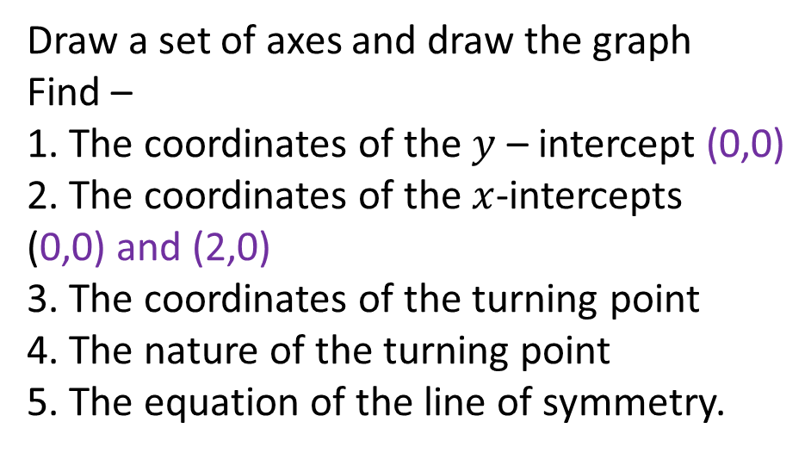
24
7
30
Date
Drawing quadratic graphs
EQ – Describe how to draw a graph in the form $y={ax}^{2}+bx+c$
Draw the line $y=x^{2}−2x$
Complete the table of values
$$x$$ | -2 | -1 | 0 | 1 | 2 | 3
$$y$$ | 8 | 3 | 0 | -1 | 0 | 3
Draw a set of axes and draw the graph
Find –
1. The coordinates of the $y$ – intercept (0,0)
2. The coordinates of the $x$-intercepts
(0,0) and (2,0)
3. The coordinates of the turning point
4. The nature of the turning point
5. The equation of the line of symmetry.
9

Slide 11
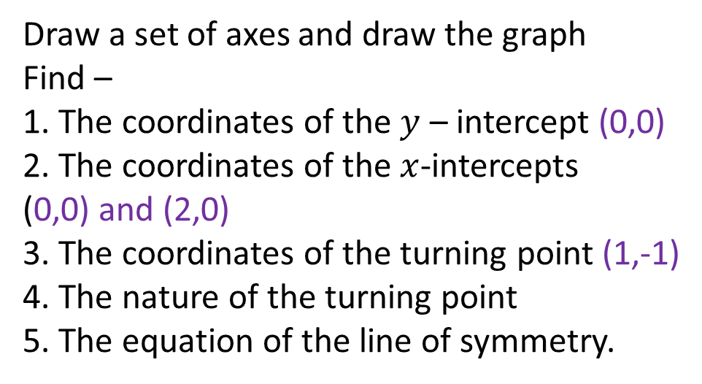
24
7
30
Date
Drawing quadratic graphs
EQ – Describe how to draw a graph in the form $y={ax}^{2}+bx+c$
Draw the line $y=x^{2}−2x$
Complete the table of values
$$x$$ | -2 | -1 | 0 | 1 | 2 | 3
$$y$$ | 8 | 3 | 0 | -1 | 0 | 3
Draw a set of axes and draw the graph
Find –
1. The coordinates of the $y$ – intercept (0,0)
2. The coordinates of the $x$-intercepts
(0,0) and (2,0)
3. The coordinates of the turning point (1,-1)
4. The nature of the turning point
5. The equation of the line of symmetry.
9

Slide 12
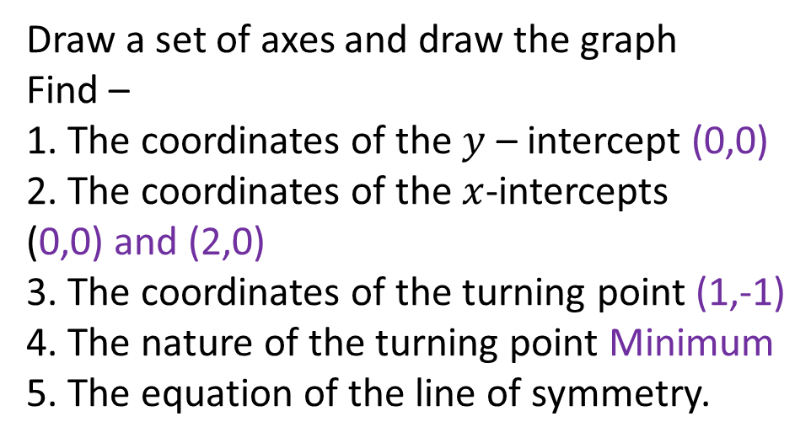
24
7
30
Date
Drawing quadratic graphs
EQ – Describe how to draw a graph in the form $y={ax}^{2}+bx+c$
Draw the line $y=x^{2}−2x$
Complete the table of values
$$x$$ | -2 | -1 | 0 | 1 | 2 | 3
$$y$$ | 8 | 3 | 0 | -1 | 0 | 3
Draw a set of axes and draw the graph
Find –
1. The coordinates of the $y$ – intercept (0,0)
2. The coordinates of the $x$-intercepts
(0,0) and (2,0)
3. The coordinates of the turning point (1,-1)
4. The nature of the turning point Minimum
5. The equation of the line of symmetry.
9

Slide 13
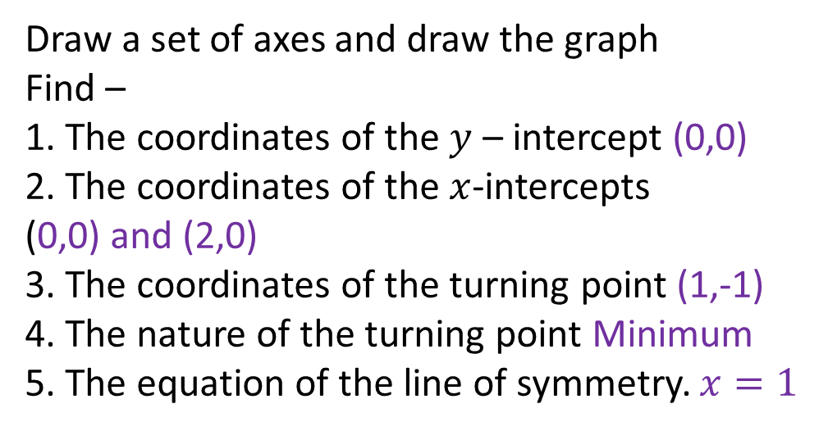
24
7
30
Date
Drawing quadratic graphs
EQ – Describe how to draw a graph in the form $y={ax}^{2}+bx+c$
Draw the line $y=x^{2}−2x$
Complete the table of values
$$x$$ | -2 | -1 | 0 | 1 | 2 | 3
$$y$$ | 8 | 3 | 0 | -1 | 0 | 3
Draw a set of axes and draw the graph
Find –
1. The coordinates of the $y$ – intercept (0,0)
2. The coordinates of the $x$-intercepts
(0,0) and (2,0)
3. The coordinates of the turning point (1,-1)
4. The nature of the turning point Minimum
5. The equation of the line of symmetry. $x=1$

Slide 14
Questions

Slide 15
Notes Review
24, 7 ,30
Date
Title
Essential question
Notes complete
Notes complete with colour and diagrams
Questions completed
Contents page filed in
Formula page filled in

Slide 16
Homework
Review your notes and write a summary answering the essential question.

